Slide 1
Explainable Prediction of Parkinson's
Disease from Resting-State Functional MRI Using Hybrid
3D CNN-LSTM Model
1
Presented By
Group 17
22266008 Salman Ibne Eunus
22273013 Asika Islam
23273003 Mitheela Das Armisha
23273004 Sakib Rokoni

Slide 2
Table of Content
2
Introduction
Literature Review
Methodology
Dataset Collection
Data Pre Processing
Choosing the Model
Deep Learning Model
Result Analysis
Future work
Conclusion

Slide 3
Introduction
3
Parkinson's Disease (PD) is the second most common neurological disorder in the aging population.
It results from decreased dopamine levels in the brain, causing motor issues.
In the initial stage (Phase 0), 90% of patients show vocal cord injury signs.
There's no cure due to the disease's complexity.
Early detection and treatment can ease symptoms, enabling a return to normal life.

Slide 4
Literature Review
Braak, H., Braak, E.
Neighbors C, Song SA. “Dysphonia
International Conference on Pervasive Computing and Communications Workshops and other Affiliated Events
4
Combination of Decision Trees, Regression, DMneural, and Neural Networks (NN), with a maximum accuracy of 92.9%
Long Short-Term Memory (LSTM) method was utilized for identifying Freezing of Gait
FOG, LSTM performs better than Support Vector Machines (SVM).
Achieve substantial reliability without making strict assumptions
Reliable marker for those with PD who are at risk of falling.
Characterized by the occurrence of olfactory loss

Slide 5
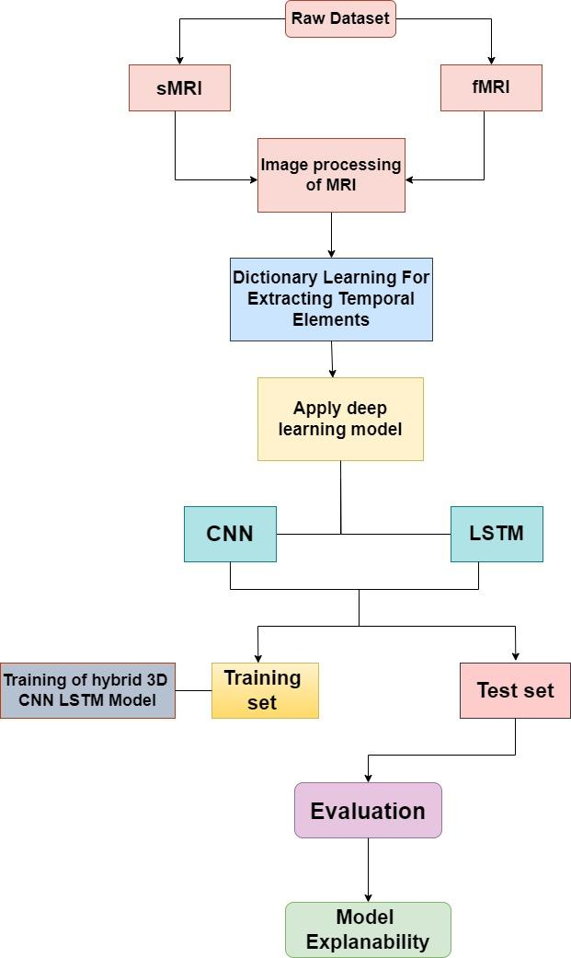
Methodology
5
After the dataset is acquired, we plan to apply several steps for the preprocessing of the fMRI images such as - motion correction, gaussian smoothing, etc.
Then we are using dictionary learning based technique which extracts a few representative temporal elements along with sparse spatial loadings, thus giving rise to good extracted maps.
We propose a hybrid three-dimensional model(CNN,LSTM) used. Then the dataset is segmented into training and test set for evaluation.
Finally, we will use model explainability tools like - GRADCAM or LIME to explain what and how the model predicts.

Slide 6
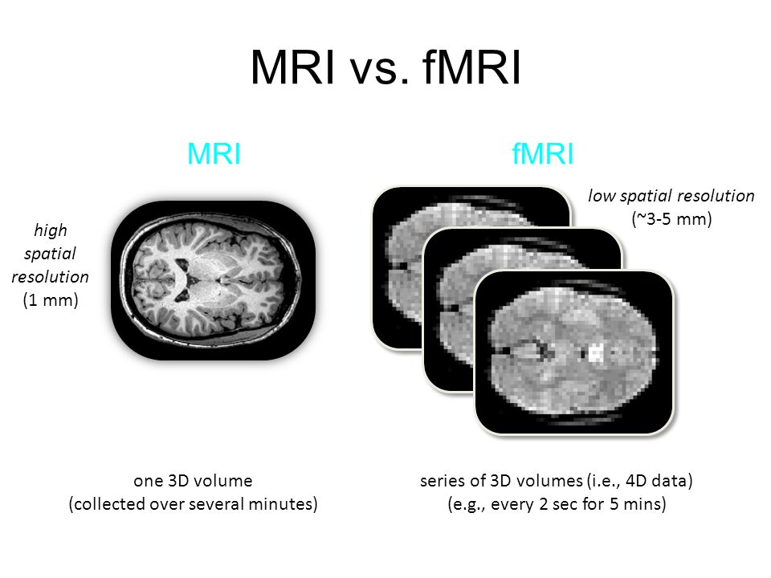
Dataset Collection
6
In this research work, we are using publicly available Parkinson’s disease datasets from National Institute for Research and Development in Informatics, Romania.
The datasets consists of MRI scan images of parkinson’s disease patients and age-matched healthy controls.
The dataset contains MRI from both anatomical and functional scans.

Slide 7
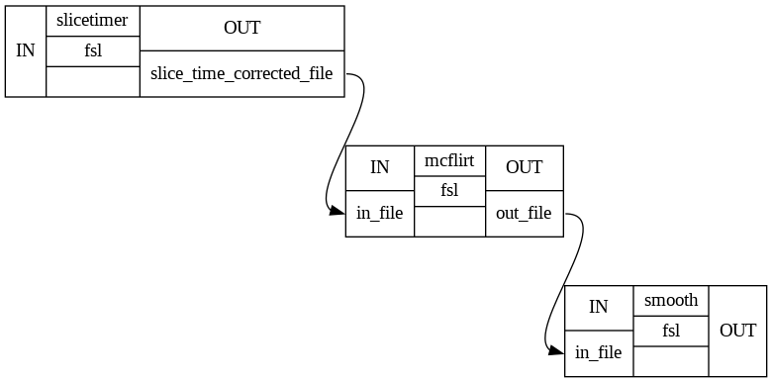
Data Preprocessing
7
Data obtained in .NII or NIIFTI (Neuroimaging Informatics Technology Initiative) format, preprocessed using techniques like - sliced time correction, motion correction and gaussian smoothing.
It is then converted to DICOM Format for machine learning model using nii2dcm package. Then images in DICOM format are converted into features and lab

Slide 8
Choosing the model(proposed model)
8
LSTM
Finding patterns in images to recognize objects, classes, and categories
LIME
To predict model accurate predicting and in which region it is predicting
CNN
Architecture
Data Augmentation
Hardware Acceleration
Training
Pooling Layers

Slide 9
Deep Learning Model
9
In general, the term “hybrid” refers to something that is a mixture of two or more things. In the context of machine learning, a hybrid model is a model that combines the strengths of two or more different models to achieve better performance than any of the individual models alone .
CNN-LSTM is a hybrid model that combines the strengths of Convolutional Neural Networks (CNNs) and Long Short-Term Memory (LSTM) networks. CNNs are excellent at extracting spatial features from images, while LSTMs are great at capturing temporal dependencies in sequential data. By combining these two models, CNN-LSTM can effectively capture both spatial and temporal features in data, making it a powerful tool for image and sequence classification tasks.
We are also using Explainable AI to correctly pinpoint what our model is predicting and in which region it is predicting using tools like - LIME.

Slide 10
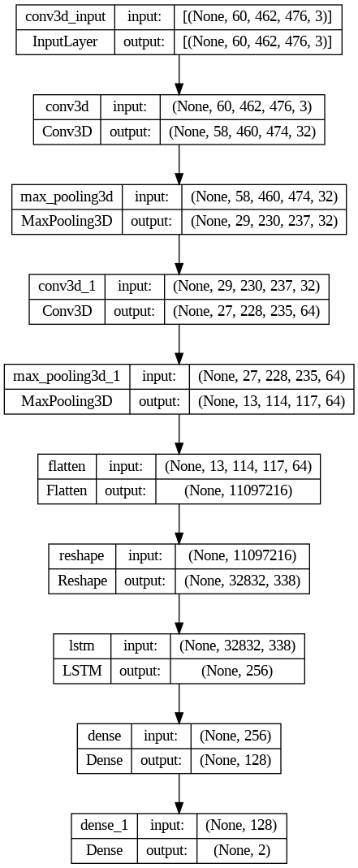
10
Deep Learning Model
(Hybrid)
CNN-LSTM

Slide 11
11
Result Analysis
We will be using metrics like - accuracy, AUC, etc. We are also using data augmentation techniques like - height shift, vertical flip, etc.
Dictionary Learning is used which is better than Independent Component Analysis (ICA) as shown in many literature and experiments.
We are using Dictionary Learning to reduce the dimensionality of 4D fMRI data. The fMRI data are transformed into 30 independent components.
Our experiment shows that dictionary learning outperforms ICA, is more stable, and thus leads to better statistical analysis.

Slide 12
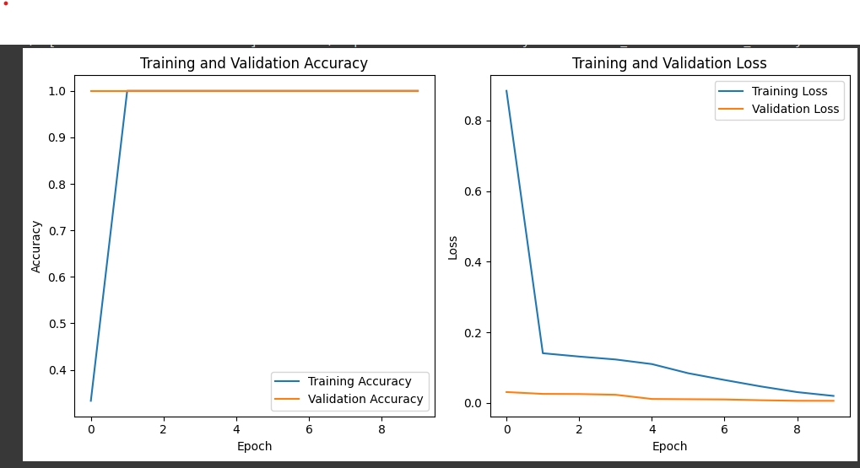
12
Result
ACCURACY 96%
Loss 0.1 %

Slide 13
Conclusion
13
Highlight the model's proficiency in recognizing nuanced patterns within medical imaging datasets USING Deep learning methodology.
Emphasize the potential utility of the model as a valuable instrument for diagnostics.
and showcase its effectiveness
Demonstrate how insights from the study contribute to the broader understanding of the disease.
Illustrate how this approach offers a pathway towards more streamlined and accurate disease identification, particularly in its nascent stages.
Connect the use of deep learning 3D model to enhanced patient outcomes through improved diagnostic accuracy.

Slide 14
Future Work
14
Dataset Enhancement
Multimodal Methodologies
Technological Integration
Sustained Inquiry
Patient Care Impact

Slide 15
Reference
15
[1] Braak, H., Braak, E. (2000) “Pathoanatomy of Parkinson’s disease” J Neurol 247, II3–II10. https://doi.org/10.1007/PL00007758 .
[2] F. Amato, I. Rechichi, L. Borz` ı and G. Olmo, (2022), ”Sleep Quality through Vocal Analysis: A Telemedicine Application,” 2022 IEEE
[3] International Conference on Pervasive Computing and Communications Workshops and other Affiliated Events (PerCom Workshops), 706- 711, doi: 10.1109/PerComWorkshops53856.2022.9767372.
[4] Neighbors C, Song SA. “Dysphonia” (2022) StatPearls [Internet]. Treasure Island (FL): StatPearls Publishing.
[5] Serge Pinto, Canan Ozsancak, Elina Tripoliti, St ́ephane Thobois, Patricia Limousin -Dowsey, Pascal Auzou, “Treatments for dysarthria in Parkinson’s disease”, (2004) The Lancet Neurology, 3(9): 547-556, ISSN 14744422, https://doi.org/10.1016/S1474-4422(04)00854-3.
[6 ]Nicol ́o G. Pozzi, Ioannis U. Isaias (2022), “Chapter 19 - Adaptive deep brain stimulation: Retuning Parkinson’s disease”, Elsevier 184: 273- 284.https://doi.org/10.1016/B978-0-12-819410-2.00015-1.
[7]Alatas Bilal, Moradi Shadi, Tapak Leili, Afshar Saeid (2022), “Identification of Novel Noninvasive Diagnostics Biomarkers in the Parkinson’s Diseases and Improving the Disease Classification Using Support Vector Machine”, BioMed Research International, Hindawi.
[8]Raundale,Pooja,ChetanThosar,andShardulRane.”Predictio of Parkinson’s disease and severity of the disease using Machine Learning and Deep Learning algorithm.” 2021 2nd International Conference for Emerging Technology (INCET). IEEE, 2021.
[9]F. Cordella, A. Paffi and A. Pallotti (2021) ”Classification-based screening of Parkinson’s disease patients through voice signal,” 2021 IEEE International Symposium on Medical Measurements and Applications (MeMeA),pp. 1-6, doi: 10.1109/MeMeA52024.2021.9478683.

Slide 16
THANK YOU!!

